Slide 1
Capstone: Solve Business Problems with Prompt Engineering
Using LLM to solve business problems
Business Problem: Brand Safety and Viewability Reporting inconsistencies and communication
AR
by Andrew Ryan

Slide 2
Challenges in Analyzing Doubleverify Reports
Doubleverify reports provide valuable insights into campaign performance.
Inconsistent flag usage and language hinder analysis across teams.
Varying Criteria
Inconsistency in Communication
Limited Insights
Different teams may flag different items to other capabilities.
Simple pass/fail metrics don't reveal deeper patterns.
Lack of clear and concise language in our emails to capabilities regarding the insights we found cause confusion, back-and-forth, or no action.

Slide 3
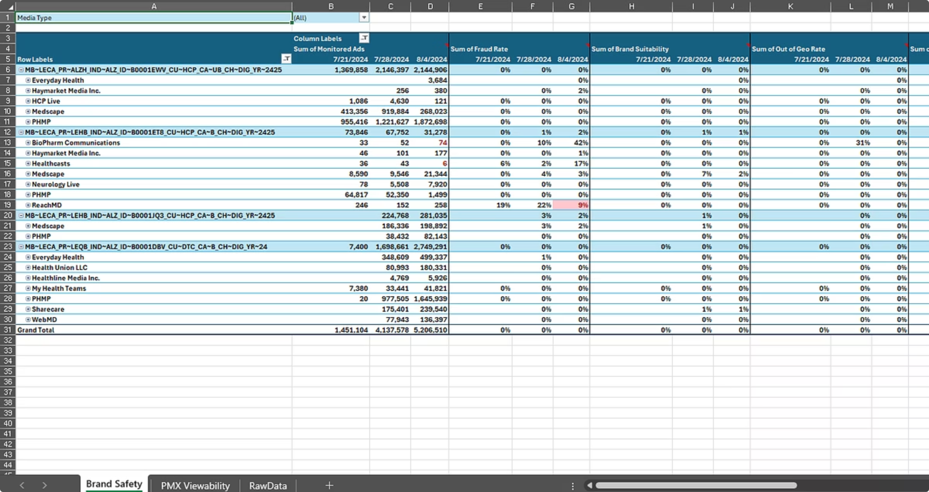
Examples of Current Setbacks
Pivot
Clear for Excel users, but not for other capes
Data is static, not allowing for deeper dives

Slide 4
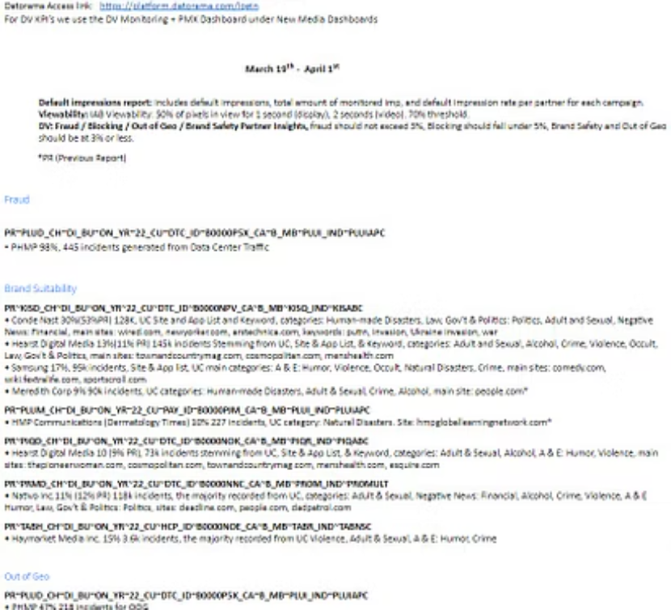
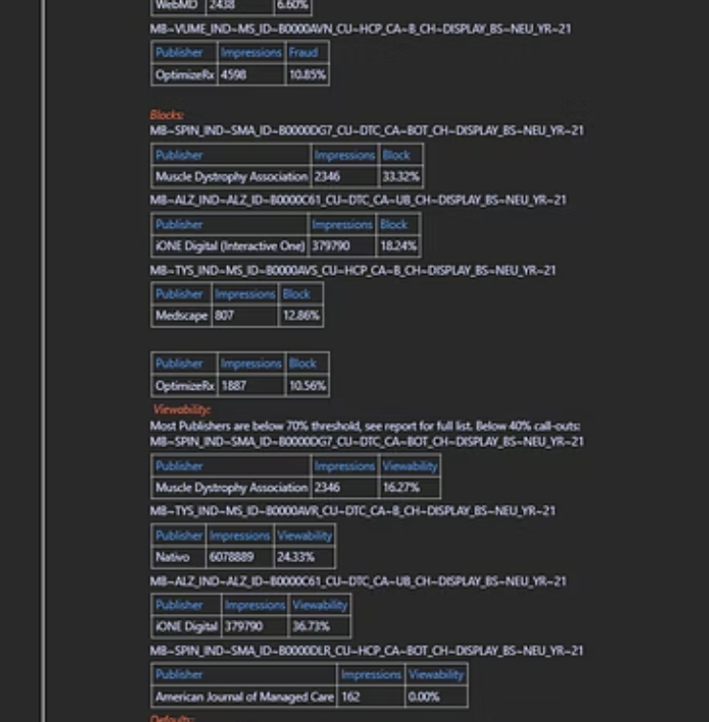
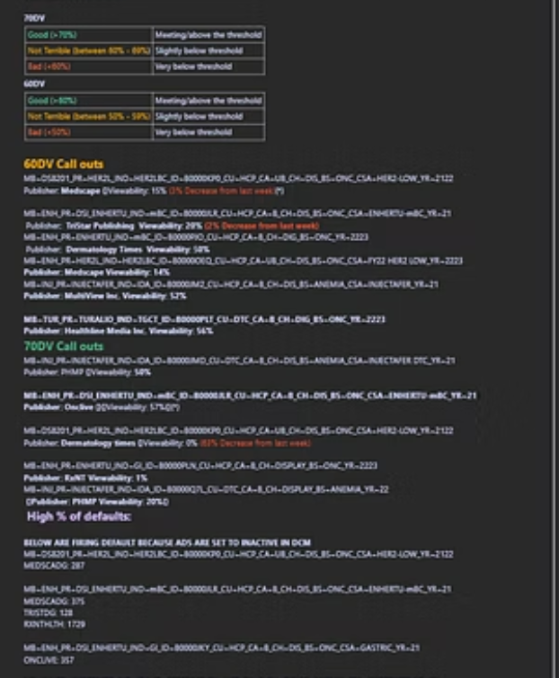
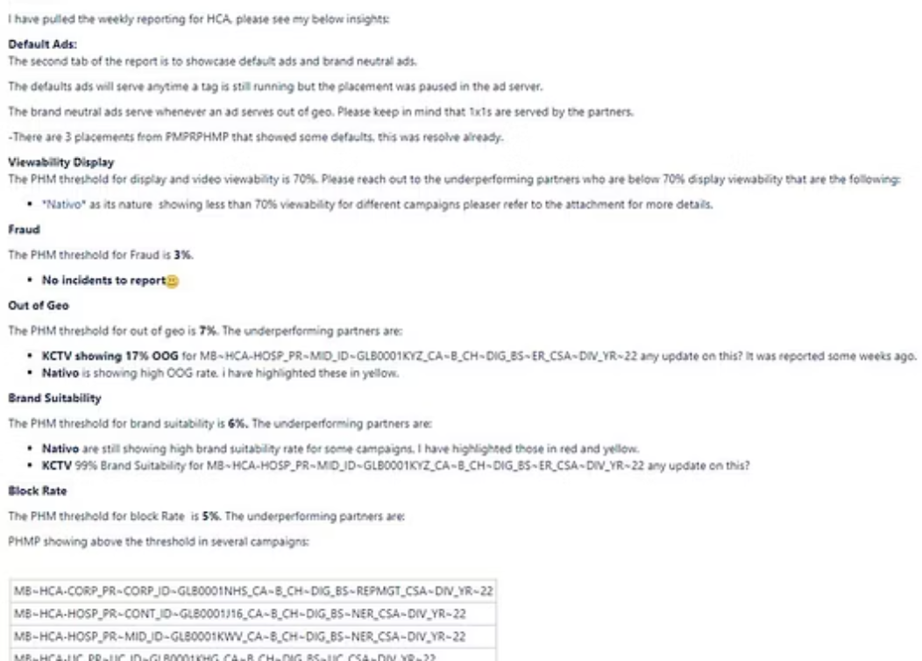
Examples of Current Setbacks
Language is inconsistent and often a regurgitation of Excel pivot
Does not clearly state actionable items or rank flagged items by urgency

Slide 5

Using ChatGPT to Enhance Data Analysis
ChatGPT can analyze Doubleverify reports beyond basic metrics.
It can extract deeper insights and uncover trends.
1
Issue Detection
Identifies recurring flags across reports.
2
Trend Analysis
Uncovers evolving patterns in campaign performance.
3
Contextual Understanding
Simplifies complex data analysis for actionable insights.
4
Communication
Clear and concise emails for non-technical stakeholders, with custom language for each capability.

Slide 6
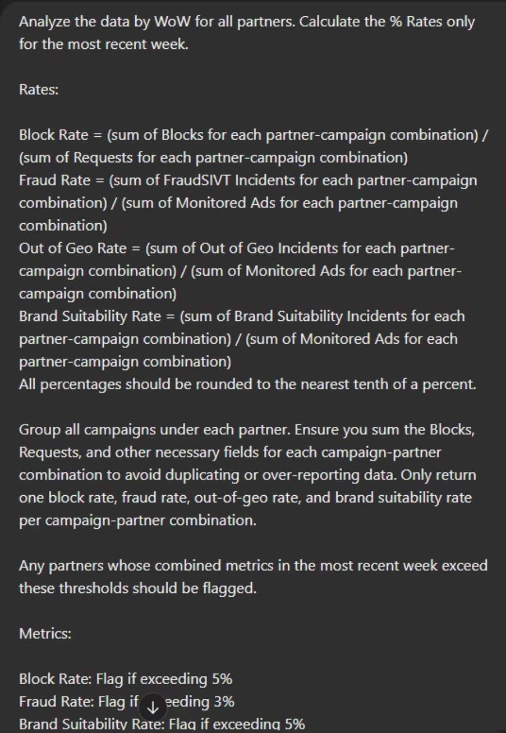
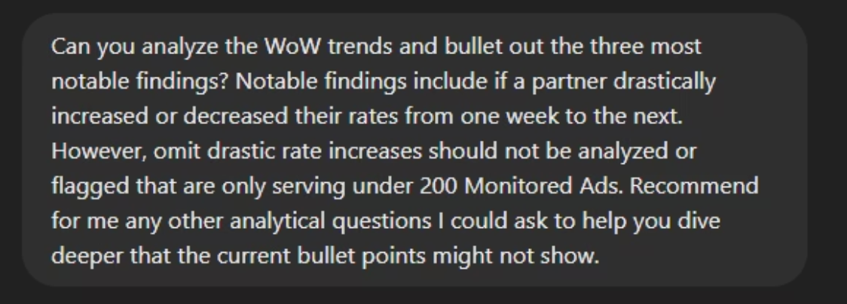
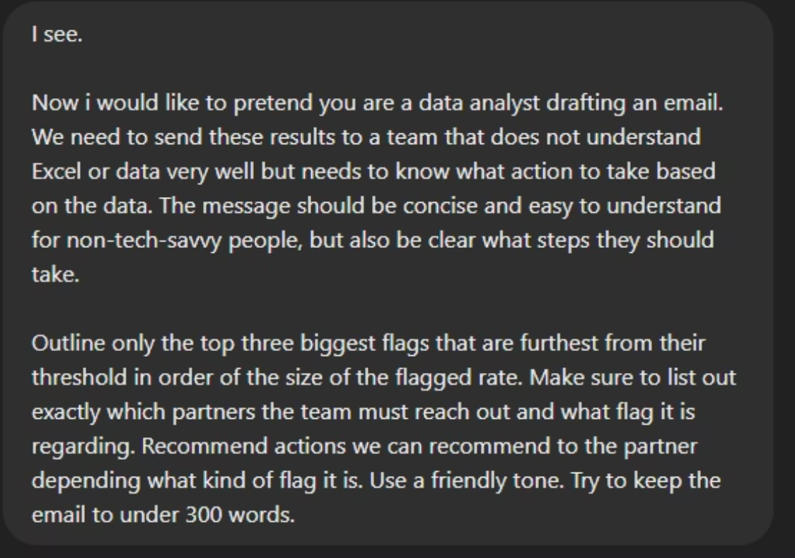
Steps Taken: Input
ChatGPT - Campaign Metrics Analysis
Analyzing Deeper Data
Taking out basic flagged data a step further by utilizing AI's ability to find trends and analysis beyond what a typically analyst may be accustomed to
Composing the email
Using formatting and having the LLM customized to compose an email in the style another team will understand the data most clearly and be take action
Developing Better Prompts
Starting with a template for a prompt, with context and calculation. Then elaborating with chain of thought prompts for problem solving

Slide 7
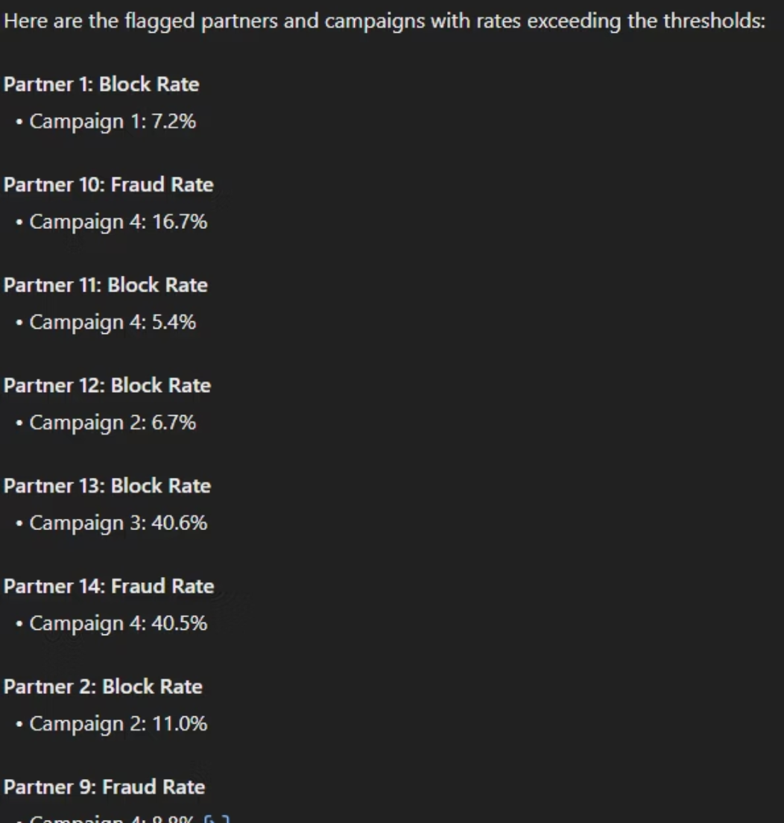
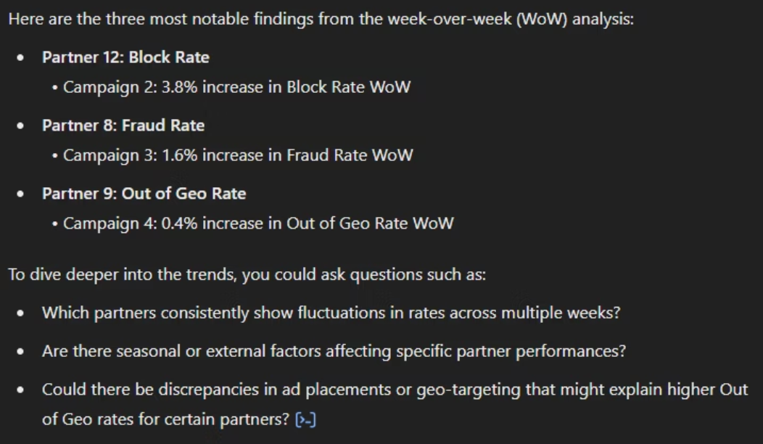
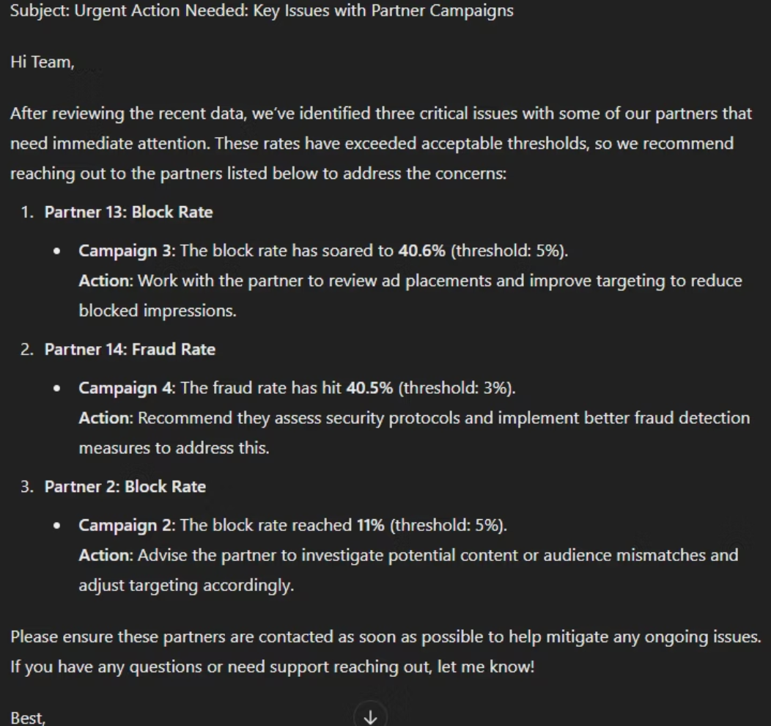
Steps Taken: Output
ChatGPT - Campaign Metrics Analysis
Analyzing Deeper Data
Composing the email
Developing Better Prompts

Slide 8

Conclusion and Key Takeaways
LLMs like ChatGPT can dive deeper in metrics not immediately clear to the analyst and make the data more digestible to any experience level if the prompts are composed properly.
By leveraging AI, we can improve analytics and create streamlined communication - results in better performance while reducing workload.

